Slide 1

Human Age Detection & Gender Detection using Human Speech

Slide 2
Content
Goal
Objectives
Pro’s & Con’s
Problem Statement
Convolutional Neural Network
Working of model & methodologies.
User Interface
Accuracy testing
Limitations
Use Cases
Conclusion
References

Slide 3
Goal
Human Age Detection
Gender Detection using Human Speech
The goal of this project is to develop an algorithm that can accurately predict a person's age based on a given input image or video.
The ultimate aim is to develop a reliable and robust system that can accurately estimate a person's age, even in challenging conditions such as low lighting or poor image quality.
Gender Identification of a speaker can be significantly used for increased natural & Personalised dialogue systems.
It aims to predict the gender of the unknown user by analysing the speech signal & determining different features obtained after analysis.

Slide 4
Literature Survey for Human age Detection
"Age Estimation using Convolutional Neural Networks" by Zhang et al. (2017): This paper proposes a deep learning model that uses CNNs to estimate the age of faces in images. The authors also compare their model's performance to other age estimation methods.
"Age and Gender Estimation using Convolutional Neural Networks and Adversarial Training" by Zhang et al. (2019): This paper proposes a deep learning model that uses CNNs and adversarial training to estimate the age and gender of faces in images. The authors demonstrate that their model outperforms other age and gender estimation methods.

Slide 5
Literature Survey for Gender Detection using Human Speech
"Gender Classification from Speech using Deep Learning" by Sainath et al. (2015): This paper proposes a deep learning model that uses CNNs to classify the gender of speakers from speech signals. The authors compare their model's performance to other gender classification methods.
"Gender Recognition from Speech using Gradient Boosting Machines" by Venkataramani et al. (2017): This paper proposes a gender recognition model that uses gradient boosting machines to classify the gender of speakers from speech signals. The authors compare their model's performance to other gender recognition methods.
"Gender Identification from Telephone Speech using Deep Learning Techniques" by Sivaraman et al. (2018): This paper proposes a deep learning model that uses CNNs and RNNs to identify the gender of speakers from telephone speech signals. The authors compare their model's performance to other gender identification methods.

Slide 6
Objectives of Human Age Detection
Predict a person's age from an input image or video with more accuracy.
Normalize the image size , video and resolution.
Validate the model's performance on a separate test dataset
Evaluate the model's robustness to various challenges,.
Deploy the model in a practical application and evaluate its performance in real-world scenarios.
Monitor the model's performance over time and update it periodically with new data or improved algorithms to maintain its accuracy and relevance.

Slide 7
Objectives of Gender Detection using Human Speech
.Preprocess the speech data to extract relevant features.
Explore different deep learning architectures, such as convolutional neural networks (CNNs) or recurrent neural networks (RNNs), that can learn to classify the speech features into male or female categories.
Train the deep learning model on the preprocessed speech data, using a suitable loss function and optimization algorithm, and validate its performance on a separate test set.
Investigate the effect of different factors and propose solutions to mitigate their impact.
Deploy the gender detection model in a practical application, such as a voice-controlled device or a speech analytics system, and evaluate its performance and user satisfaction.

Slide 8
Pro’s & Con’s: Human Age Detection
Pro’s
Con’s
Accurate: Deep learning models can achieve high accuracy in age prediction, especially when trained on large and diverse datasets.
Efficient: Age detection can be done quickly and automatically.
Non-invasive: Age detection from images or videos is non-invasive and does not require any physical contact or discomfort for the subject.
Versatile: Age detection using deep learning can be applied in various domains.
Privacy concerns:
Limited applicability:
Dataset bias: Age detection models trained on biased or unrepresentative datasets may produce inaccurate or discriminatory results, especially if they reflect societal biases or stereotypes.
Sensitivity to image quality: Age detection accuracy can be affected by image quality, lighting conditions, or camera angle, which can introduce noise or distortions in the input data.
Lack of interpretability: Deep learning models are often black boxes, meaning that their decision-making process is opaque and difficult to explain or interpret, which can limit their transparency and accountability.
N

Slide 9
Pro’s & Con’s: Gender Detection using Human Speech
Pro’s
Con’s
Accurate: High accuracy in gender detection from speech.
Efficient:
Non-invasive: It does not require any physical contact or discomfort for the subject.
Versatile: Gender detection can be applied in various domains, such as speech recognition, voice-controlled devices, or speech analytics, to provide personalized services or insights.
Limited applicability: May not be applicable in all scenarios or populations.
Dataset bias:
Sensitivity to noise: Accuracy can be affected by background noise, speech distortions, or other environmental factors .
Lack of interpretability: Deep learning models are often black boxes, meaning that their decision-making process is opaque and difficult to explain or interpret, which can limit their transparency and accountability.

Slide 10
Problem Statement
Human Age Detection
Gender Detection using Human Speech
To develop a deep learning-based model that can accurately estimate the age of a human from facial features extracted from an image or video input. The model should be able to handle variations in lighting conditions, facial expressions, and occlusions, and provide robust age estimation results across diverse demographic groups.
To develop a machine learning model that can accurately detect the gender of a speaker from their speech input. The model should be able to handle variations in language, dialect, and accent, and should be able to provide reliable gender classification results across diverse demographic groups. Additionally, the model should be able to process speech inputs in real-time and should be scalable to handle large volumes of data.

Slide 11
Convolutional Neural Network
CNN is a type of deep learning algorithm that is commonly used for image recognition, computer vision, and natural language processing tasks.
It consists of several layers of learnable filters that apply convolutions to the input data, in order to extract high-level features and patterns that are relevant to the task.
Filters reduce the number of parameters in the model & also captures the local & global dependencies.
The output of each layer is fed into the next layer, which can perform further transformations or reduce the dimensionality of the data using pooling or subsampling operations.
The final layer of the CNN typically consists of one or more fully connected layers, which combine the extracted features and make a prediction about the output.

Slide 12
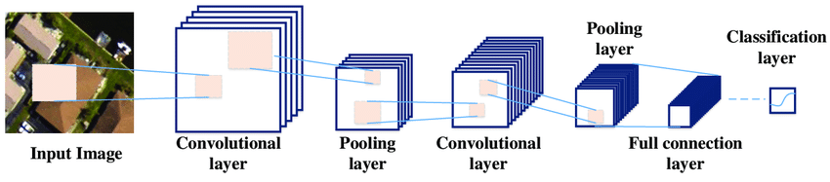
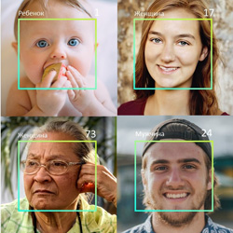
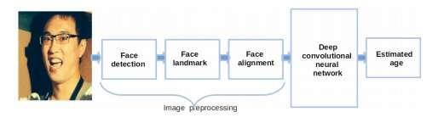
Working of CNN for Human Age Detection

Slide 13
In human age detection, CNNs are trained on large datasets of images of faces, along with their corresponding age labels.
The CNN consists of several layers, including convolutional layers, pooling layers, and fully connected layers.
Convolutional layers: apply filters to the input image to extract important features and create feature maps.
Pooling layers : down sample the feature maps to reduce the dimensionality and make the network more efficient.
Fully connected layers : take the flattened feature maps and use them to make a prediction about the age of the person in the input image.
During training, the CNN adjusts the weights of its layers to minimize the difference between its predicted ages and the true ages of the input images.
Once the CNN is trained, it can be used to predict the age of new input images that it hasn't seen before.
The accuracy of the CNN's age predictions can be evaluated using metrics such as mean absolute error or mean squared error.

Slide 14
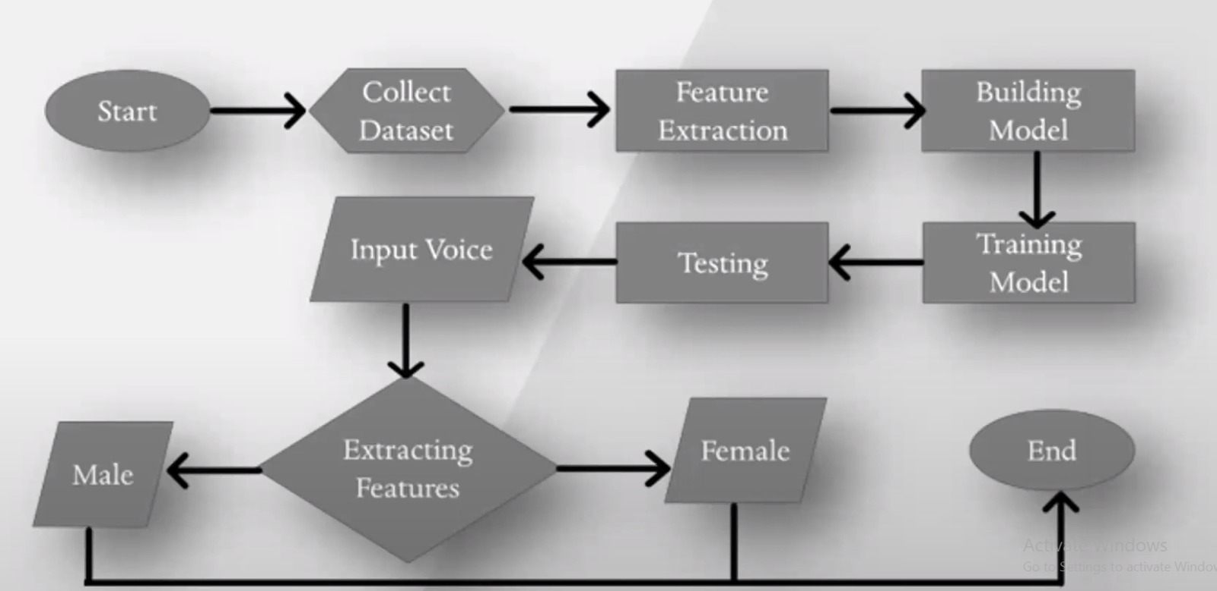
Gender Detection using human speech (Working)

Slide 15
Speech
Signal
Pre-processing
RNN (LSTM/GRU)
Output
Layer
Gender Prediction

Slide 16
Steps for Gender Detection using human speech
Data Collection: The first step is to collect a dataset of audio recordings of male and female speakers. The dataset should be diverse in terms of accents, age, and background noise.
Data Preprocessing: The audio files need to be preprocessed before they can be fed into a deep learning model. This involves converting the audio into a spectrogram, which is a visual representation of the audio signal.
Feature Extraction: Once the spectrograms are created, features need to be extracted from them. These features can include pitch, frequency, and formants.
Model Training: The next step is to train a deep learning model using the extracted features as input. This can be done using various deep learning frameworks such as TensorFlow, Keras, or PyTorch.
Model Evaluation: After training the model, it needs to be evaluated to determine its accuracy. This can be done using a test set of audio files that were not used during training.
Model Deployment: Once the model is trained and evaluated, it can be deployed in a real-world application. This could involve integrating the model into a speech recognition system.

Slide 17


Slide 18



User Interface for Human Age Detection
Drag and Drop an Image of a Human
Submit
Submit
Submit
Analyze

Slide 19

User Interface for Gender detection
Submit
Submit
Analyze

Slide 20
Accuracy Testing
Input the data
Create a frame
Detect the face
Process the image
Classify the Gender
Classify the Age Group
Attach the result in image
Output the image in specified location

Slide 21
Limitations
Pose
Facial Expression
Imaging Condition
Age
Face Sze
Different Facial Features
Illumination

Slide 22
Use Cases
In a marketing organisation, he target audience is identified.
During the recruitment process, to ensure the applicant’s validity.
Verification of the identity of those applying for government identification.
In the medical sector, a forensic department collects information about decreased people.
In the banking industry, age & gender detection can be used to extract the information about an individual from photo
During criminal investigation also it is useful.

Slide 23
Conclusion
Human Age Detection
Gender Detection using Human Speech
It is a promising area of research with potential applications in various fields, such as healthcare and entertainment industries.
By using video images as input and implementing deep learning models such as CNNs or RNNs, we can accurately estimate a person's age.
Video images provide a richer source of information than still images, which can help in better feature extraction and improving the accuracy of the age estimation models.
developing effective models requires high-quality training datasets, robust preprocessing techniques for feature extraction, and careful selection of deep learning algorithms. Also, speech signals introduce additional challenges such as background noise, accents, and variations in speaking styles, which should be considered when developing the models.

Slide 24
Reference
https://www.analyticsvidhya.com/blog/2021/07/age-and-gender-detection-using-deep-learning/
https://slideplayer.com/slide/15749019/
https://pyimagesearch.com/2020/04/13/opencv-age-detection-with-deep-learning/
https://www.youtube.com/watch?v=5PjUakojMww

Slide 25


